Slide 1

Informed Search
Read AIMA 3.1-3.6.
Some materials will not
be covered in lecture, but
will be on the midterm.

Slide 2
Reminder – HW due tonight
HW1 is due tonight before 11:59pm.
Please submit early. 1 second late = 1 late day.
Verify by this afternoon that you have a Gradescope account for the class. Private post on Piazza if you don’t.
HW2 has been released. It is due in 1 week. It is on Uninformed Search. Start early.

Slide 3
Other logistics
Course policies have been clarified
Grading: There roughly one homework assignment per week, aside from weeks with exams. Students enrolled in CIS 421 may skip one HW assignment, or they may discard their lowest scoring HW assignment. Students enrolled in CIS 521 must complete all HW assignments and cannot discard their lowest scoring assignment.
Collaboration: You are not allowed to upload your code to publicly accessible places (like public github repositories), and you are not allowed to access anyone else’s code.

Slide 4
Review: Search problem definition
States: a set S
An initial state s_{i}∈S
Actions: a set A
∀ s Actions(s) = the set of actions that can be executed in s, that are applicable in s.
Transition Model: ∀ s∀ a∈Actions(s) Result(s, a) → s_{r}
s_{r} is called a successor of s
{s_{i} }∪ Successors(s_{i} )* = state space
Path cost (Performance Measure): Must be additive
e.g. sum of distances, number of actions executed, …
c(x,a,y) is the step cost, assumed ≥ 0
(where action a goes from state x to state y)
Goal test: Goal(s)
Can be implicit, e.g. checkmate(s)
s is a goal state if Goal(s) is true

Slide 5
Review: Useful Concepts
State space: the set of all states reachable from the initial state by any sequence of actions
When several operators can apply to each state, this gets large very quickly
Might be a proper subset of the set of configurations
Path: a sequence of actions leading from one state s_{j} to another state s_{k}
Frontier: those states that are available for expanding (for applying legal actions to)
Solution: a path from the initial state s_{i} to a state s_{g} that satisfies the goal test

Slide 6
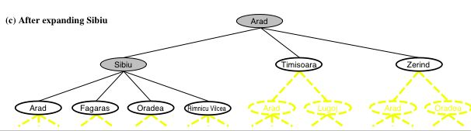
Review: Tree search
function TREE-SEARCH(problem, strategy) return a solution or failure
Initialize frontier to the initial state of the problem
do
if the frontier is empty then return failure
choose leaf node for expansion according to strategy & remove from frontier
if node contains goal state then return solution
else expand the node and add resulting nodes to the frontier
6
Notes:
Shaded nodes are the ones that have been expanded
Nodes that have been generated by not yet expanded are outlined in bold.
Others are in dashed yellow lines
Can be extended to graph search by keeping track of what nodes have already been explored, and not re-exploring them.
Review: Strategy = order of tree expansion
Implemented by different queue structures (LIFO, FIFO, priority)

Slide 7
Review: Search Strategies
Strategy = order of tree expansion
Implemented by different queue structures (LIFO, FIFO, priority)
Dimensions for evaluation
Completeness- always find the solution?
Optimality - finds a least cost solution (lowest path cost) first?
Time complexity - # of nodes generated (worst case)
Space complexity - # of nodes simultaneously in memory (worst case)
Time/space complexity variables
b, maximum branching factor of search tree
d, depth of the shallowest goal node
m, maximum length of any path in the state space (potentially ∞)

Slide 8

Breadth first search
https://youtu.be/x-VTfcmrLEQ
Notes:
https://youtu.be/x-VTfcmrLEQ

Slide 9
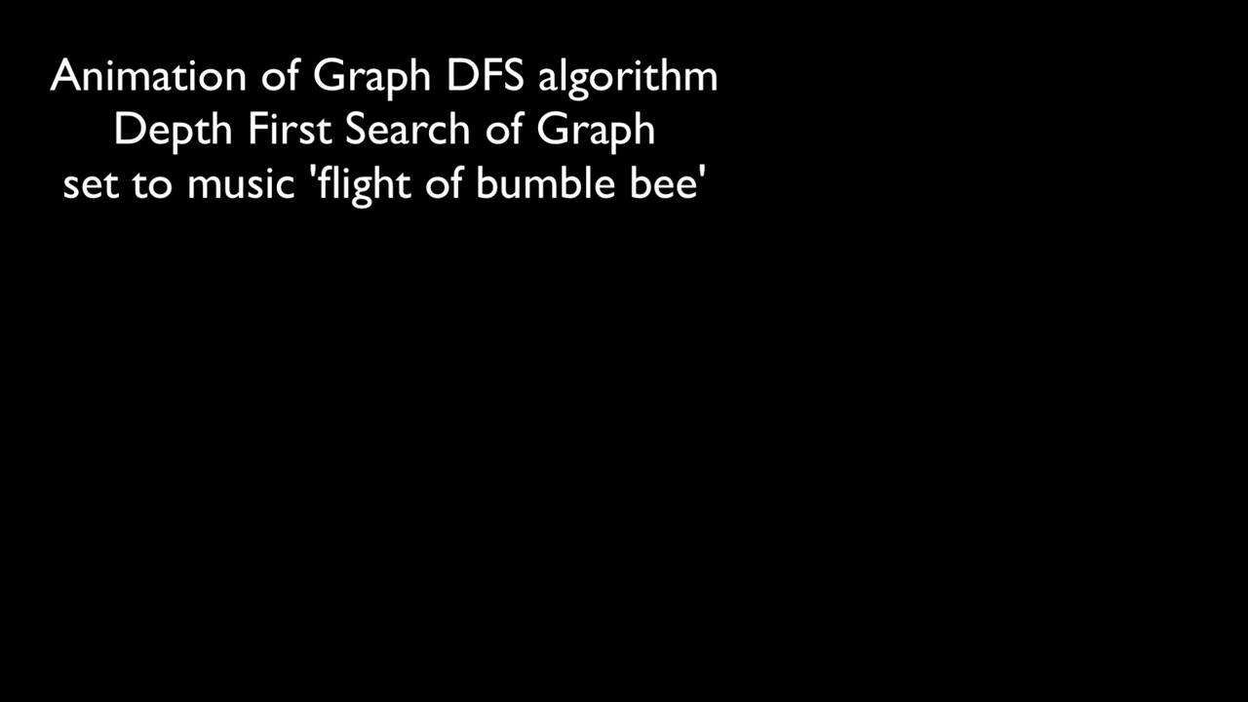
Depth first search
https://y2mate.com/youtube/NUgMa5coCoE
https://youtu.be/NUgMa5coCoE
Notes:
https://youtu.be/x-VTfcmrLEQ?t=7s

Slide 10
Review: Breadth-first search
Idea:
Expand shallowest unexpanded node
Implementation:
frontier is FIFO (First-In-First-Out) Queue:
Put successors at the end of frontier successor list.
Image credit: Dan Klein and Pieter Abbeel
http://ai.berkeley.edu

Slide 11

Review: Depth-first search
Idea:
Expand deepest unexpanded node
Implementation:
frontier is LIFO (Last-In-First-Out) Queue:
Put successors at the front of frontier successor list.
Image credit: Dan Klein and Pieter Abbeel
http://ai.berkeley.edu

Slide 12

Fringe Strategies with One Queue
These search algorithms are the same except for fringe strategies
DFS strategy = LIFO stack
BSF strategy = FIFO queue
Conceptually, all fringes are priority queues (i.e. collections of nodes with attached priorities)
You can even code one implementation that takes a variable queuing object
Slide credit: Dan Klein and Pieter Abbeel
http://ai.berkeley.edu

Slide 13
“Uniform Cost” Search
“In computer science, uniform-cost search (UCS) is a tree search algorithm used for traversing or searching a weighted tree, tree structure, or graph.” - Wikipedia
Notes:
13

Slide 14
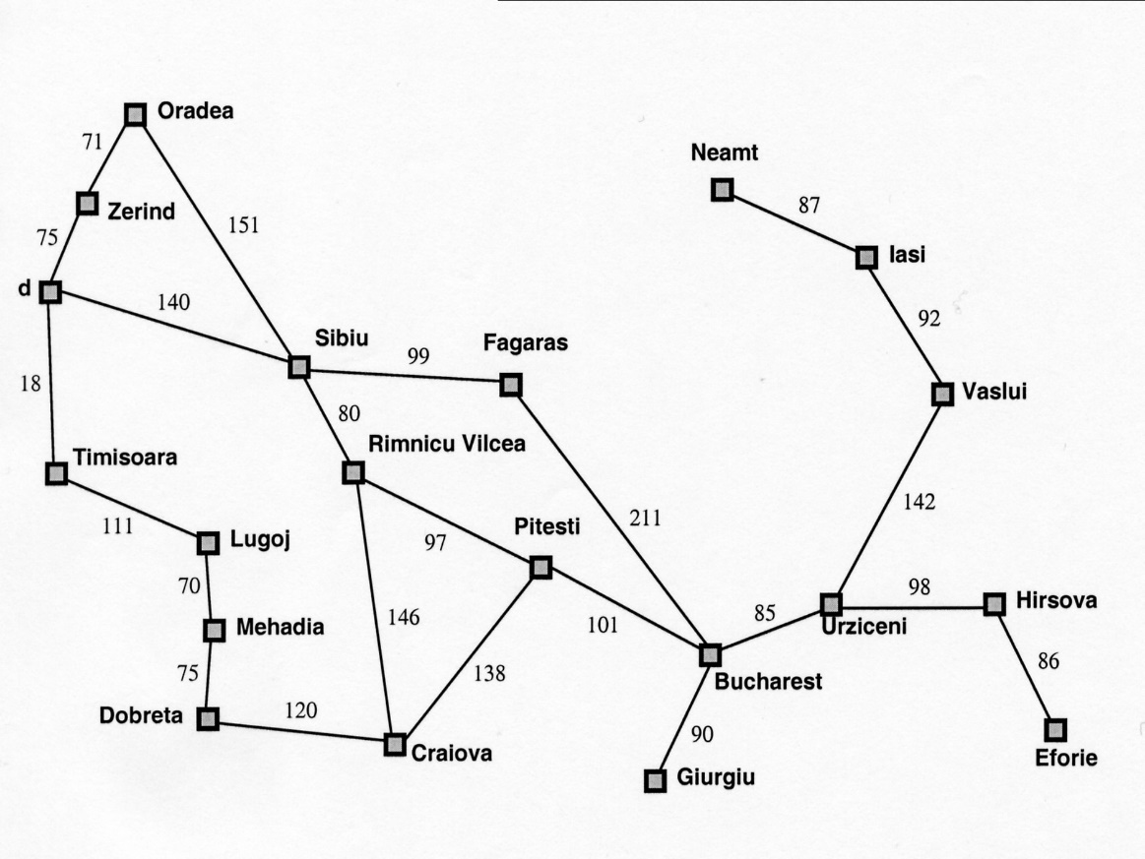
Motivation: Romanian Map Problem
Arad
118
All our search methods so far assume step-cost = 1
This is only true for some problems

Slide 15
g(N): the path cost function
Our assumption so far: All moves equal in cost
Cost = # of nodes in path-1
g(N) = depth(N) in the search tree
More general: Assigning a (potentially) unique cost to each step
N₀, N₁, N₂, N₃ = nodes visited on path p from N₀ to N₃
C(i,j): Cost of going from N_{i} to N_{j}
If N₀ the root of the search tree, g(N3)=C(0,1)+C(1,2)+C(2,3)

Slide 16
Uniform-cost search (UCS)
Extension of BF-search:
Expand node with lowest path cost
Implementation: frontier = priority queue ordered by g(n)
Subtle but significant difference from BFS:
Tests if a node is a goal state when it is selected for expansion, not when it is added to the frontier.
Updates a node on the frontier if a better path to the same state is found.
So always enqueues a node before checking whether it is a goal.
WHY???

Slide 17
Uniform Cost Search
Slide from Stanford CS 221 (from slide by Dan Klein (UCB) and many others)
Expand cheapest node first:
Frontier is a priority queue
No longer ply at a time, but follows cost contours
Therefore: Must be optimal
2
G
a
b
1
8
c
2
2
3
d
e
f
9
8
1
S
h
1
1
p
q
r
15
S
0
d
3
e
9
p
1
b
4
c
e
5
h
17
r
11
q
16
11
Cost contours
a
6
a
h
13
r
7
p
q
f
p
q
f
8
q
c
G
q
c
a
11
G
10
a
Notes:
NOTE: Dijkstra’s algorithm just UCS without goal

Slide 18
Complexity of UCS
Complete!
Optimal!
if the cost of each step exceeds some positive bound ε.
Time complexity: O(b^{C*/ε + 1})
Space complexity: O(b^{C*/ε + 1})
where C* is the cost of an optimal solution, and ε is min(C(i,j))
(if all step costs are equal, this becomes O(b^{d+1})
NOTE: Dijkstra’s algorithm just UCS without goal

Slide 19
Summary of algorithms (for notes)
Criterion | Breadth-First | Uniform-cost | Depth-First | Depth-limited | Iterative deepening | Bidirectional search
Complete? | YES | YES | NO | NO | YES | YES
Time | b^{d} | b^{(C*/e)+1} | b^{m} | b^{l} | b^{d} | b^{d/2}
Space | b^{d} | b^{(C*/e)+1} | bm | bl | bd | b^{d/2}
Optimal? | YES | YES | NO | NO | YES | YES
Assumes b is finite

Slide 20
Outline for today’s lecture
Uninformed Search
Briefly: Bidirectional Search
“Uniform Cost” Search (UCS)
Informed Search
Introduction to Informed search
Heuristics
1st attempt: Greedy Best-first search

Slide 21

Is Uniform Cost Search the best we can do? Consider finding a route from Bucharest to Arad..
g(n)<300
Arad
118
g(n)<200
g(n)<100

Slide 22
Is Uniform Cost Search the best we can do? Consider finding a route from Bucharest to Arad..
g(n)<300
Arad
118
g(n)<200
g(n)<100
WRONG
WAY!!!!

Slide 23
A Better Idea…
Node expansion based on an estimate which includes distance to the goal
General approach of informed search:
Best-first search: node selected for expansion based on an evaluation function f(n)
f(n) includes estimate of distance to goal (new idea!)
Implementation: Sort frontier queue by this new f(n).
Special cases: greedy search, A* search

Slide 24
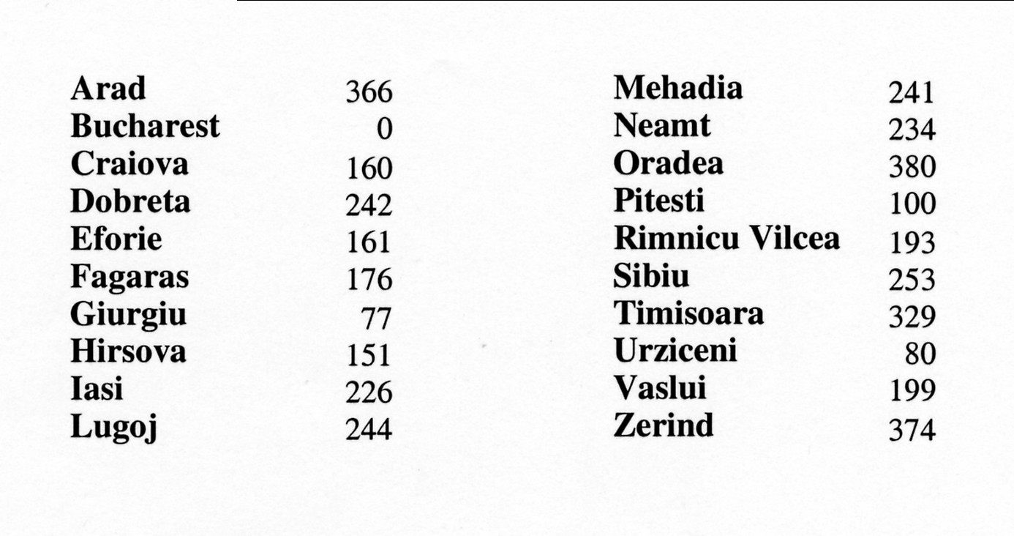
Simple, useful estimate heuristic: straight-line distances
Arad
118

Slide 25

Heuristic (estimate) functions
Heureka! ---Archimedes
[dictionary]“A rule of thumb, simplification, or educated guess that reduces or limits the search for solutions in domains that are difficult and poorly understood.”
Heuristic knowledge is useful, but not necessarily correct.
Heuristic algorithms use heuristic knowledge to solve a problem.
A heuristic function h(n) takes a state n and returns an estimate of the distance from n to the goal.
(graphic: http://hyperbolegames.com/2014/10/20/eureka-moments/)

Slide 26
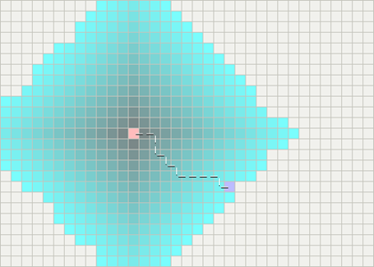
Breadth First for Games, Robots, …
Pink: Starting Point
Blue: Goal
Teal: Scanned squares
Darker: Closer to starting point…
Graphics from
http://theory.stanford.edu/~amitp/GameProgramming/
(A great site for practical AI & game Programming
Notes:
CCB – consider replacing these with animations.

Slide 27

vs. an optimal informed search algorithm (A*)
We add a heuristic estimate of distance to the goal
Yellow: examined nodes with high estimated distance
Blue: examined nodes with low estimated distance

Slide 28
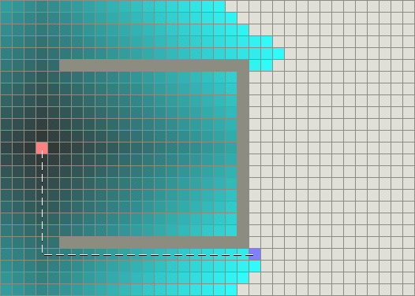
Breadth first in a world with obstacles

Slide 29
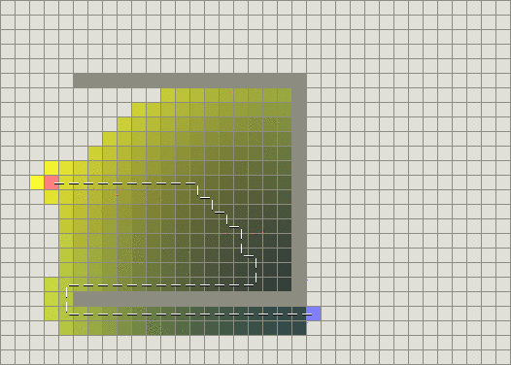
Greedy best-first search in a world with obstacles

Slide 30
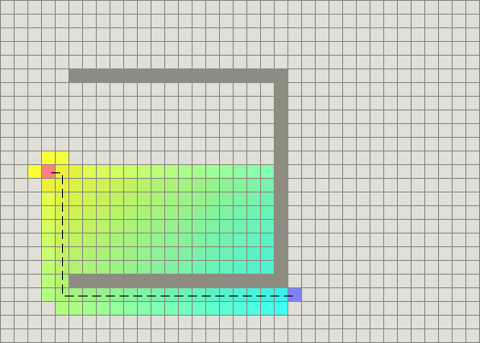
Informed search (A*) in a world with obstacles

Slide 31
Outline for today’s lecture
Uninformed Search
Briefly: Bidirectional Search
“Uniform Cost” Search (UCS)
Informed Search
Introduction to Informed search
Heuristics
1st attempt: Greedy Best-first search (AIMA 3.5.1)

Slide 32
Review: Best-first search
Basic idea:
select node for expansion with minimal evaluation function f(n)
where f(n) is some function that includes estimate heuristic h(n) of the remaining distance to goal
Implement using priority queue
Exactly UCS with f(n) replacing g(n)

Slide 33
Greedy best-first search: f(n) = h(n)
Expands the node that is estimated to be closest to goal
Completely ignores g(n): the cost to get to n
Here, h(n) = h_{SLD}(n) = straight-line distance from ` to Bucharest

Slide 34

Greedy best-first search example
Frontier queue:
Arad 366
Initial State = Arad
Goal State = Bucharest
Notes:
Ccb – show slide 17 on the second screen.

Slide 35

Greedy best-first search example
Frontier queue:
Sibiu 253
Timisoara 329
Zerind 374

Slide 36

Greedy best-first search example
Frontier queue:
Fagaras 176
Rimnicu Vilcea 193
Timisoara 329
Arad 366
Zerind 374
Oradea 380

Slide 37

Greedy best-first search example
Frontier queue:
Bucharest 0
Rimnicu Vilcea 193
Sibiu 253
Timisoara 329
Arad 366
Zerind 374
Oradea 380
Goal reached !!

Slide 38
Properties of greedy best-first search
Optimal?
No!
Found: Arad → Sibiu → Fagaras → Bucharest (450km)
Shorter: Arad → Sibiu → Rimnicu Vilcea → Pitesti→ Bucharest (418km)
Arad
118

Slide 39
Properties of greedy best-first search
Complete?
No – can get stuck in loops,
e.g., Iasi → Neamt → Iasi → Neamt →…
Initial
Goal

Slide 40
Properties of greedy best-first search
Complete? No – can get stuck in loops,
e.g., Iasi → Neamt → Iasi → Neamt → …
Time? O(b^{m}) – worst case (like Depth First Search)
But a good heuristic can give dramatic improvement of average cost
Space? O(b^{m}) – priority queue, so worst case: keeps all (unexpanded) nodes in memory
Optimal? No

Slide 41
IF TIME
Optimal informed search: A* (AIMA 3.5.2)

Slide 42
A* search
Best-known form of best-first search.
Key Idea: avoid expanding paths that are already expensive, but expand most promising first.
Simple idea: f(n)=g(n) + h(n)
g(n) the actual cost (so far) to reach the node
h(n) estimated cost to get from the node to the goal
f(n) estimated total cost of path through n to goal
Implementation: Frontier queue as priority queue by increasing f(n) (as expected…)

Slide 43
Key concept: Admissible heuristics
A heuristic h(n) is admissible if it never overestimates the cost to reach the goal; i.e. it is optimistic
Formally:∀n, n a node:
h(n) ≤ h*(n) where h*(n) is the true cost from n
h(n) ≥ 0 so h(G)=0 for any goal G.
Example: h_{SLD}(n) never overestimates the actual road distance
Theorem: If h(n) is admissible, A* using Tree Search is optimal

Slide 44


Idea: Admissibility
Inadmissible (pessimistic) heuristics break optimality by trapping good plans on the fringe
Admissible (optimistic) heuristics slow down bad plans but never outweigh true costs
Slide credit: Dan Klein and Pieter Abbeel
http://ai.berkeley.edu
Notes:
Admissibility has to be true of every state in your state space. If there’s any state for which it’s not true, then we might make the true best past seem too bad to appear at the top of the priority queue.

Slide 45

A* search example
Frontier queue:
Arad 366

Slide 46

A* search example
Frontier queue:
Sibiu 393
Timisoara 447
Zerind 449
We add the three nodes we found to the Frontier queue.
We sort them according to the g()+h() calculation.

Slide 47

A* search example
Frontier queue:
Rimricu Vicea 413
Fagaras 415
Timisoara 447
Zerind 449
Arad 646
Oradea 671
When we expand Sibiu, we run into Arad again. Note that we’ve already expanded this node once; but we still add it to the Frontier queue again.

Slide 48

A* search example
Frontier queue:
Fagaras 415
Pitesti 417
Timisoara 447
Zerind 449
Craiova 526
Sibiu 553
Arad 646
Oradea 671
We expand Rimricu Vicea.

Slide 49

A* search example
Frontier queue:
Pitesti 417
Timisoara 447
Zerind 449
Bucharest 450
Craiova 526
Sibiu 553
Sibiu 591
Arad 646
Oradea 671
When we expand Fagaras, we find Bucharest, but we’re not done. The algorithm doesn’t end until we “expand” the goal node – it has to be at the top of the Frontier queue.

Slide 50

A* search example
Frontier queue:
Frontier queue:
Bucharest 418
Timisoara 447
Zerind 449
Bucharest 450
Craiova 526
Sibiu 553
Sibiu 591
Rimricu Vicea 607
Craiova 615
Arad 646
Oradea 671
Note that we just found a better value for Bucharest!
Now we expand this better value for Bucharest since it’s at the top of the queue.
We’re done and we know the value found is optimal!

Slide 51
Outline for today’s lecture
Informed Search
Optimal informed search: A*
Creating good heuristic functions (AIMA 3.6)
Hill Climbing

Slide 52
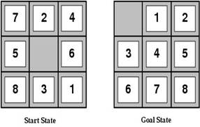
Heuristic functions
For the 8-puzzle
Avg. solution cost is about 22 steps
(branching factor ≤ 3)
Exhaustive search to depth 22: 3.1 x 10¹⁰ states
A good heuristic function can reduce the search process
Notes:
Exhaustive search like BFS

Slide 53

Example Admissible heuristics
For the 8-puzzle:
h_{oop}(n) = number of out of place tiles
h_{md}(n) = total Manhattan distance (i.e., # of moves from desired location of each tile)
h_{oop}(S) = 8
h_{md}(S) = 3+1+2+2+2+3+3+2 = 18
Notes:
OOP = out of place
MD = Manhattan distance. Let’s assume that I can move single squares. Start with tile 1. Needs to move up up, left = 3 moves.

Slide 54
Relaxed problems
A problem with fewer restrictions on the actions than the original is called a relaxed problem
The cost of an optimal solution to a relaxed problem is an admissible heuristic for the original problem
If the rules of the 8-puzzle are relaxed so that a tile can move anywhere, then h_{oop}(n) gives the shortest solution
If the rules are relaxed so that a tile can move to any adjacent square, then h_{md}(n) gives the shortest solution

Slide 55
Defining Heuristics: h(n)
Cost of an exact solution to a relaxed problem (fewer restrictions on operator)
Constraints on Full Problem:
A tile can move from square A to square B if A is adjacent to B and B is blank.
Constraints on relaxed problems:
A tile can move from square A to square B if A is adjacent to B. (h_{md})
A tile can move from square A to square B if B is blank.
A tile can move from square A to square B. (h_{oop})
Notes:
Two constraints (in blue and in red).
Drop one or drop both.

Slide 56
Dominance: A metric on better heuristics
If h₂(n) ≥ h₁(n) for all n (both admissible)
then h₂ dominates h₁
So h₂ is optimistic, but more accurate than h₁
h₂ is therefore better for search
Notice: h_{md} dominates h_{oop}
Typical search costs (average number of nodes expanded):
d=12 Iterative Deepening Search = 3,644,035 nodes A*(h_{oop}) = 227 nodes A*(h_{md}) = 73 nodes
d=24 IDS = too many nodes A*(h_{oop}) = 39,135 nodes A*(h_{md}) = 1,641 nodes
Notes:
h2 dominates h1 if ….
h2 is still optimistic, but it’s closer to the truth than h1.
Manhattan distance dominates out of place.

Slide 57
The best and worst admissible heuristics
h*(n) - the (unachievable) Oracle heuristic
h*(n) = the true distance from the root to n
h_{we’re here already}(n)= h_{teleportation}(n)=0
Admissible: both yes!!!
h*(n) dominates all other heuristics
h_{teleportation}(n) is dominated by all heuristics

Slide 58

Optimality of A* Tree Search
Slide credit: Dan Klein and Pieter Abbeel
http://ai.berkeley.edu

Slide 59
Admissibility
Inadmissible (pessimistic) heuristics break optimality by trapping good plans on the fringe
Admissible (optimistic) heuristics slow down bad plans but never outweigh true costs
Slide credit: Dan Klein and Pieter Abbeel
http://ai.berkeley.edu
Notes:
Optimistic must be true of every state in your state space. If any state is an not optimistic estimate, then heuristic is inadmissible.

Slide 60


Admissible Heuristics
A heuristic h is admissible (optimistic) if:
where is the true cost to a nearest goal
Is Manhattan Distance admissible?
Coming up with admissible heuristics is most of what’s involved in using A* in practice.
Notes:
h*(n) is the cheapest way of reaching your goal.
h(n) must be positive.
Yes, Manhattan Distance is admissible. Ask students why?

Slide 61


Optimality of A* Tree Search
Assume:
A is an optimal goal node
B is a suboptimal goal node
h is admissible
Claim:
A will exit the fringe before B
…
Slide credit: Dan Klein and Pieter Abbeel
http://ai.berkeley.edu
Notes:
Claim we will prove first. If we can prove this then we know we’ve found an optimal path to the goal.

Slide 62




Optimality of A* Tree Search: Blocking
Proof:
Imagine B is on the fringe
Some ancestor n of A is on the fringe, too (maybe A!)
Claim: n will be expanded before B
f(n) is less or equal to f(A)
…
Definition of f-cost
Admissibility of h
h = 0 at a goal
Slide credit: Dan Klein and Pieter Abbeel
http://ai.berkeley.edu
Notes:
We always have some ancestor of A, since we will either have the root, or some child that expands from it and leads to A. (It could be A itself)

Slide 63


Optimality of A* Tree Search: Blocking
Proof:
Imagine B is on the fringe
Some ancestor n of A is on the fringe, too (maybe A!)
Claim: n will be expanded before B
f(n) is less or equal to f(A)
f(A) is less than f(B)
…
B is suboptimal
h = 0 at a goal
Slide credit: Dan Klein and Pieter Abbeel
http://ai.berkeley.edu

Slide 64

Optimality of A* Tree Search: Blocking
Proof:
Imagine B is on the fringe
Some ancestor n of A is on the fringe, too (maybe A!)
Claim: n will be expanded before B
f(n) is less or equal to f(A)
f(A) is less than f(B)
n expands before B
All ancestors of A expand before B
A expands before B
A* search is optimal
…
Slide credit: Dan Klein and Pieter Abbeel
http://ai.berkeley.edu

Slide 65
Properties of A*
Slide credit: Dan Klein and Pieter Abbeel
http://ai.berkeley.edu
Notes:
A* is optimal with an admissible heuristic.

Slide 66
Properties of A*
Uniform-Cost
A*
b
b
…
…
Slide credit: Dan Klein and Pieter Abbeel
http://ai.berkeley.edu
Notes:
A* targets goal states more directly than UCS

Slide 67
UCS vs A* Contours
Uniform-cost expands equally in all “directions”
A* expands mainly toward the goal, but does hedge its bets to ensure optimality
Start
Goal
Start
Goal
Slide credit: Dan Klein and Pieter Abbeel
http://ai.berkeley.edu

Slide 68
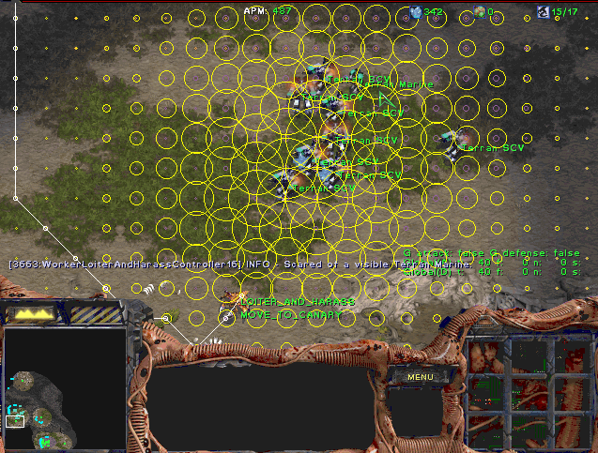
A* Applications
Video games
Pathing / routing problems (A* is in your GPS!)
Resource planning problems
Robot motion planning
…
Slide credit: Dan Klein and Pieter Abbeel
http://ai.berkeley.edu
Notes:
A lot of games where you have to move troops around using A*

Slide 69
Constraint Satisfaction Problems
Thursday’s lecture will be by TAs Maria and Deniz
Read AIMA 6.1-6.5

Slide 70
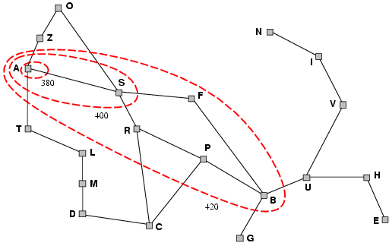
Optimality of A* (intuitive)
Lemma: A* expands nodes on frontier in order of increasing f value
Gradually adds "f-contours" of nodes
Contour i has all nodes with f=f_{i}, where f_{i} < f_{i+1}
(After all, A* is just a variant of uniform-cost search….)

Slide 71
Optimality of A* using Tree-Search (proof idea )
Lemma: A* expands nodes on frontier in order of increasing f value
Suppose some suboptimal goal G₂ (i.e a goal on a suboptimal path) has been generated and is in the frontier along with an optimal goal G.
Must prove: f(G₂) > f(G)
(Why? Because if f(G₂) > f(n), then G₂ will never get to the front of the priority queue.)
Proof:
g(G₂) > g(G) since G₂ is suboptimal
f(G₂) = g(G₂) since f(G₂)=g(G₂)+h(G₂) & h(G₂) = 0, since G₂ is a goal
f(G) = g(G) similarly
f(G₂) > f(G) from 1,2,3
Also must show that G is added to the frontier before G₂ is expanded – see AIMA for argument in the case of Graph Search

Slide 72
A* search, evaluation
Completeness: YES
Since bands of increasing f are added
As long as b is finite
(guaranteeing that there aren’t infinitely many nodes n with f (n) < f(G) )
Time complexity: Same as UCS worst case
Number of nodes expanded is still exponential in the length of the solution.
Space complexity: Same as UCS worst case
It keeps all generated nodes in memory so exponential
Hence space is the major problem not time
Optimality: YES
Cannot expand f_{i+1} until f_{i} is finished.
A* expands all nodes with f(n)< f(G)
A* expands one node with f(n)=f(G)
A* expands no nodes with f(n)>f(G)

Slide 73
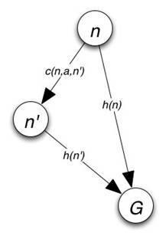
Consistency
A heuristic is consistent if
Consistency enforces that h(n) is optimistic
Theorem: if h(n) is consistent, A* using Graph-Search
is optimal
See book for details
Cost of getting from n to n’ by any action a

